Slide 1

Website Design With CSS
Chapter 5 Intro – CSS Timeline

Slide 2
Project Description
We will be creating a responsive timeline which can map years and points of interests in each year
The point of this project is to change up from common “boxy” webpages
The timeline will be fully responsive and will adapt to any screen size

Slide 3
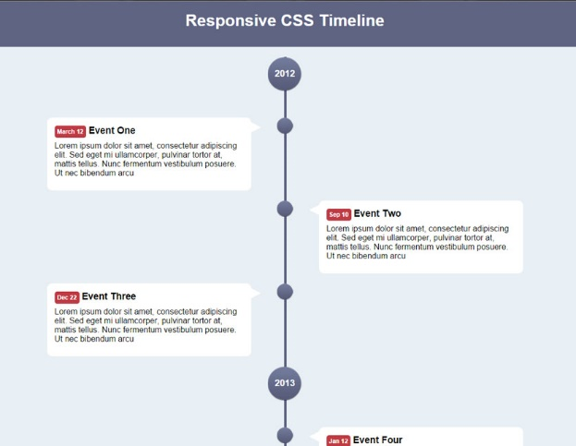
Project Sections
Project Introduction
Timeline HTML Markup
Timeline Base CSS
Timeline Inner CSS
Mobile & Responsive CSS

Slide 4
What You Will Learn
Clean HTML5 Markup
Positioning/aligning less ‘boxy’ type elements
Using background images
HTML5 <time> element
Responsive layout

Slide 5
THAT’S IT!

